Slide 1

WELCOME
COHORT 5
11th May – 6th Aug 2026
Suite 6-6-7, Level 6, Menara MAA

Slide 2
Contents
What is React and why it matters
Setting up development environment
Creating your first React app
Project structure deep dive
JSX introduction
React Developer Tools

Slide 3
What is React?
A JavaScript library for building user interfaces
Created by Facebook (Meta) in 2013
Component-based architecture
Declarative programming paradigm
Virtual DOM for performance optimization

Slide 4
Why use React?
Component reusability = faster development
Virtual DOM = better performance
Rich ecosystem = extensive tooling
SEO-friendly with Next.js
Mobile development with React Native

Slide 5
Why React Matters in Modern Web Development
Industry Adoption:
• Used by Netflix, Airbnb, Instagram, WhatsApp
• 40%+ of developers use React (Stack Overflow 2023)
• Highest job demand among frontend frameworks

Slide 6
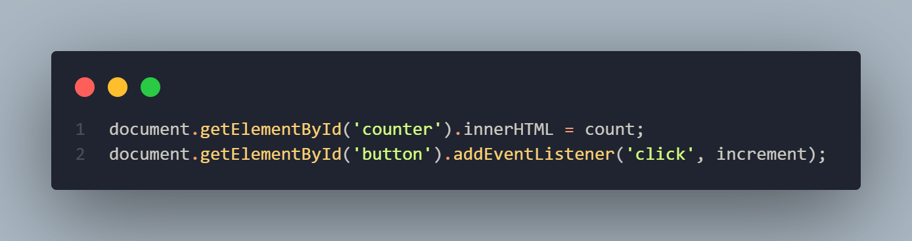
React vs Traditional JavaScript
Traditional Javascript

Slide 7
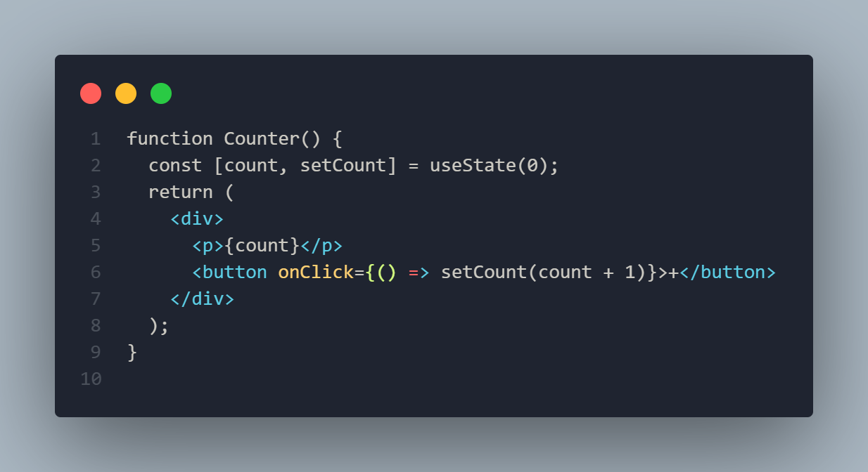
React vs Traditional JavaScript
React

Slide 8
Why Vite over Create React App
Vite (Modern Choice):
Lightning fast development server
Instant hot module replacement
Smaller bundle sizes
Better development experience
Industry standard for new projects
Create React App:
Slower development server
Heavier configuration
Facebook is no longer maintaining it
Being phased out in the industry

Slide 9
Project Structure Overview
my-react-app/
|── public/ # Static assets
| |── index.html # Main HTML file
|── src/ # Source code
| |── components/ # Reusable components
| |── App.jsx # Main app component
| |── main.jsx # Entry point
|── package.json # Dependencies & scripts
|── vite.config.js # Vite configuration

Slide 10
Introduction to JSX
JSX = JavaScript XML
Syntax extension for JavaScript
Looks like HTML but it's JavaScript
Gets compiled to React.createElement() calls

Slide 11
JSX Rules:
Must return single parent element
Use className instead of class
Self-closing tags must end with />
Use camelCase for attributes
Embed JavaScript with {}

Slide 12
Setting Up Development Environment
Step 1: Install Node.js
# Check if Node.js is installed
node --version
npm --version

Slide 13
Setting Up Development Environment
Step 2: Create React App with Vite
# Create new React project
npm create vite@latest my-first-react-app -- --template react
# Navigate to project
cd my-first-react-app
# Install dependencies
npm install
# Start development server
npm run dev

Slide 14
Understanding Project Structure
package.json
  Stores libraries
  Settings to start, build and preview servers
src/main.jsx
  Entry Point
  This is where React connects to the HTML
src/App.jsx
  The main component that renders all other components

Slide 15
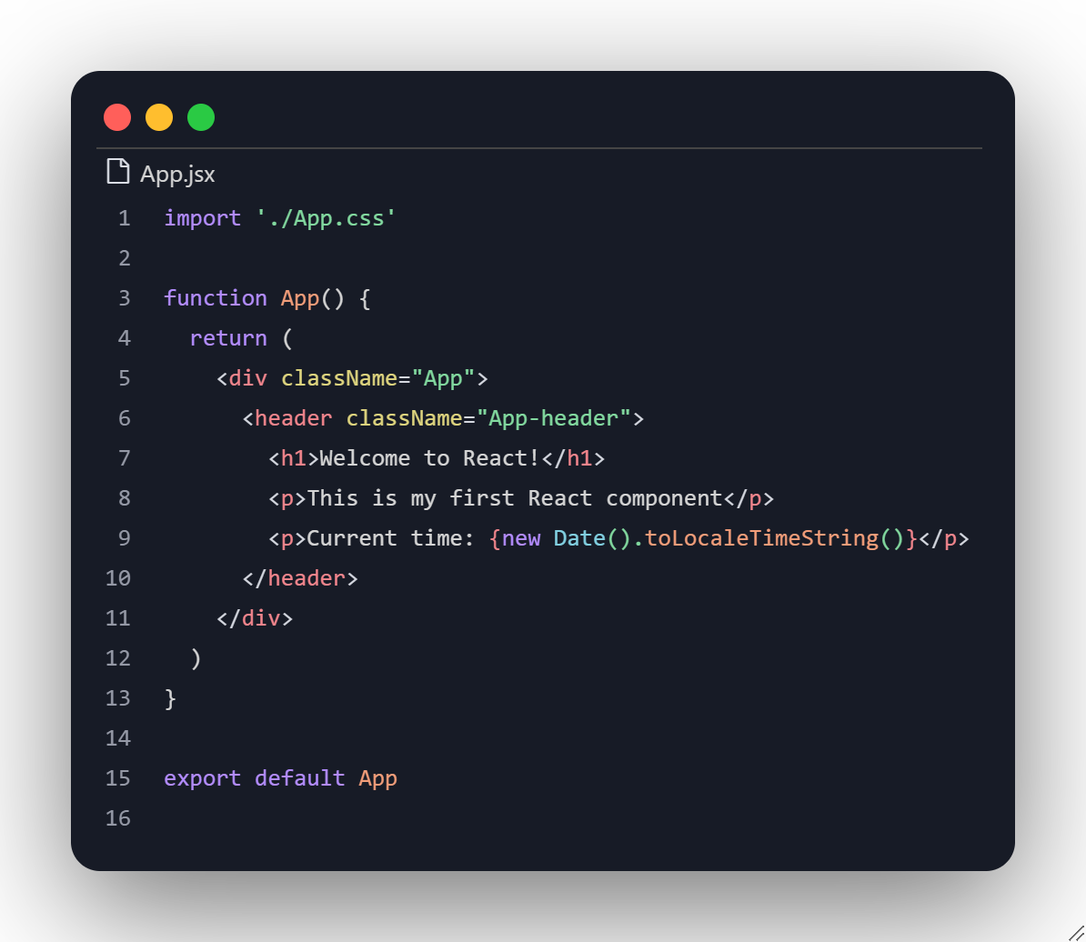
Your First React Component

Slide 16
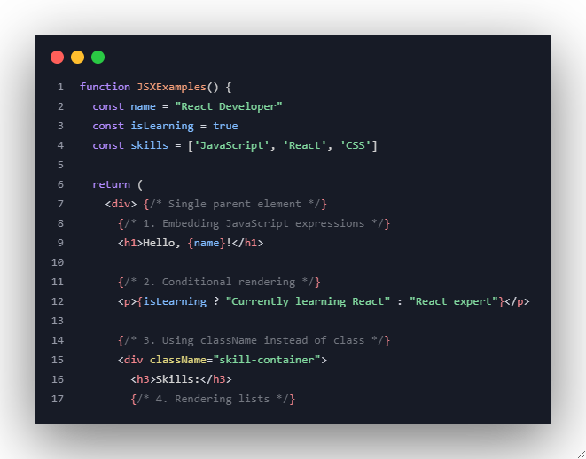
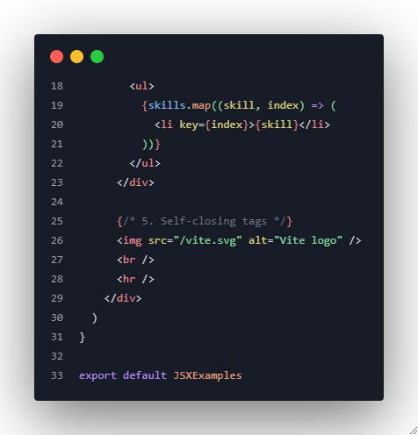
Your First React Component

Slide 17
Exercise 1: Environment Setup Verification
Task: Verify your development environment is working correctly.
Instructions:
Create a new React project called "react-practice"
Start the development server
Modify the default App component to display your name

Slide 18
Exercise 1: Environment Setup Verification
Expected Result:
Development server runs on localhost:5173
Page displays your name instead of default content
No console errors

Slide 19
Exercise 2: Basic JSX Practice
Task: Create a component that demonstrates JSX features.
Instructions:
Create a new component called PersonalInfo.jsx with:
Your name in an h1 tag
Your favorite programming language in a paragraph
A list of 3 hobbies
Current date and time
An image (use any online image URL)

Slide 20
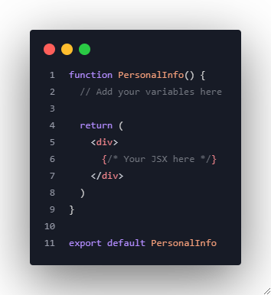
Exercise 2: Basic JSX Practice

Slide 21
Exercise 3: Project Structure Exploration
Task: Understand the project structure by making specific changes.
Instructions:
Create a new folder src/components
Move your PersonalInfo component to this folder
Import and use it in App.jsx
Add a custom CSS file for your component
Verify everything still works

Slide 22
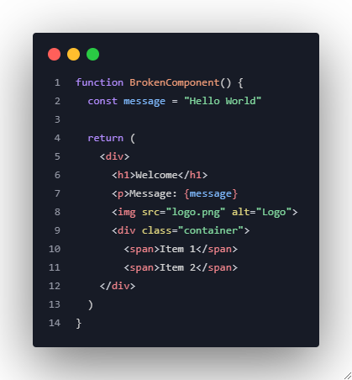
Exercise 4: JSX Error Fixing
Task: Fix the JSX errors in the provided code.

